Slide 1
Design and Analysis of Algorithms
Lecture 8
Instructor: Mehak Riaz Khan
Email: Mehak.riaz@kiet.edu.pk

Slide 2
Heap Sort
Like merge sort, it’s running time is O(nlogn)
It sorts in place.

Slide 3
QuickSort
Uses Divide and Conquer approach
Best case is O(nlogn)
Worst case is O(n²)
On average, it is faster than the heapsort, due to a highly optimized inner loop.

Slide 4
QuickSort
Quicksort sorts by employing a divide and conquer strategy to divide a list into two sub-lists.
The steps are:
Pick an element, called a pivot, from the list.
Reorder the list so that all elements which are less than the pivot come before the pivot and all elements greater than the pivot come after it (equal values can go either way). After this partitioning, the pivot is in its final position. This is called the partition operation.
Recursively sort the sub-list of lesser elements and the sub-list of greater elements.
The base case of the recursion are lists of size zero or one, which are always sorted.

Slide 5
QuickSort:
More formally: for an array A[p .. r]:

Slide 6
QuickSort
Some points:
Base case includes the possibility that the set A might be empty.
Algorithm allows any number to be a pivot.
The pivot divides the set into two subsets:
The left subset contains values smaller than the pivot
The right subset contains values greater than the pivot.
Obviously some choice for pivot are better than others.

Slide 7
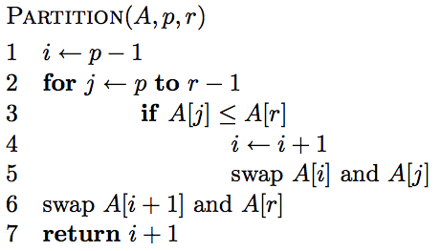
A[r] is called the pivot
Partitions the elements A[p…r-1] in to two sets, those ≤ pivot and those > pivot
Operates in place
Final result:
p
pivot
r
A
≤ pivot
> pivot

Slide 8
… 5 7 1 2 8 4 3 6 …
p
r

Slide 9
i
… 5 7 1 2 8 4 3 6 …
p
r

Slide 10
i
j
… 5 7 1 2 8 4 3 6 …
p
r

Slide 11
i
j
… 5 7 1 2 8 4 3 6 …
p
r

Slide 12
i
j
… 5 7 1 2 8 4 3 6 …
p
r

Slide 13
i
j
… 5 7 1 2 8 4 3 6 …
p
r

Slide 14
i
j
… 5 7 1 2 8 4 3 6 …
p
r

Slide 15
i
j
… 5 7 1 2 8 4 3 6 …
p
r

Slide 16
i
j
… 5 7 1 2 8 4 3 6 …
p
r

Slide 17
i
j
… 5 1 7 2 8 4 3 6 …
p
r

Slide 18
i
j
… 5 1 7 2 8 4 3 6 …
p
r

Slide 19
i
j
… 5 1 7 2 8 4 3 6 …
p
r

Slide 20
i
j
… 5 1 2 7 8 4 3 6 …
p
r

Slide 21
i
j
… 5 1 2 7 8 4 3 6 …
p
r

Slide 22
i
j
… 5 1 2 7 8 4 3 6 …
p
r
What’s happening?

Slide 23
i
j
… 5 1 2 7 8 4 3 6 …
p
r
≤ pivot
> pivot
unprocessed

Slide 24
i
j
… 5 1 2 7 8 4 3 6 …
p
r

Slide 25
i
j
… 5 1 2 4 8 7 3 6 …
p
r

Slide 26
i
j
… 5 1 2 4 3 7 8 6 …
p
r

Slide 27
i
j
… 5 1 2 4 3 6 8 7 …
p
r

Slide 28
i
j
… 5 1 2 4 3 6 8 7 …
p
r

Slide 29
Partition running time?
Θ(n)

Slide 30
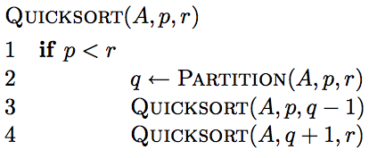
Quicksort

Slide 31
8 5 1 3 6 2 7 4

Slide 32
8 5 1 3 6 2 7 4

Slide 33
1 3 2 4 6 8 7 5

Slide 34
1 3 2 4 6 8 7 5

Slide 35
1 3 2 4 6 8 7 5

Slide 36
1 2 3 4 6 8 7 5

Slide 37
1 2 3 4 6 8 7 5

Slide 38
1 2 3 4 6 8 7 5

Slide 39
1 2 3 4 6 8 7 5

Slide 40
1 2 3 4 6 8 7 5

Slide 41
1 2 3 4 5 8 7 6
What happens here?

Slide 42
1 2 3 4 5 8 7 6

Slide 43
1 2 3 4 5 8 7 6

Slide 44
1 2 3 4 5 6 7 8

Slide 45
1 2 3 4 5 6 7 8

Slide 46
Analysis of quicksort—best case
Suppose each partition operation divides the array almost exactly in half
Then the depth of the recursion in log₂n
Because that’s how many times we can halve n
However, there are many recursions!
How can we figure this out?
We note that
Each partition is linear over its subarray
All the partitions at one level cover the array

Slide 47
Partitioning at various levels

Slide 48
Best case II
We cut the array size in half each time
So the depth of the recursion in log₂n
At each level of the recursion, all the partitions at that level do work that is linear in n
O(log₂n) * O(n) = O(n log₂n)
Hence in the average case, quicksort has time complexity O(n log₂n)
What about the worst case?

Slide 49
Worst case partitioning

Slide 50
Worst Case Intuition
n-1
n-1
t(n) =
0
n-2
n-2
0
n-3
n-3
0
n-4
n-4
.
.
.
0
1
1
0
0
0

Slide 51
Worst case for quicksort
In the worst case, recursion may be n levels deep (for an array of size n)
But the partitioning work done at each level is still n
O(n) * O(n) = O(n²)
So worst case for Quicksort is O(n²)
When does this happen?
There are many arrangements that could make this happen
Here are two common cases:
When the array is already sorted
When the array is inversely sorted

Slide 52
Picking a better pivot
Before, we picked the last element of the subarray to use as a pivot
If the array is already sorted, this results in O(n²) behavior
It’s no better if we pick the first element
We could do an optimal quicksort (guaranteed O(n log n)) if we always picked a pivot value that exactly cuts the array in half
Such a value is called a median: half of the values in the array are larger, half are smaller
The easiest way to find the median is to sort the array and pick the value in the middle (!)

Slide 53
Median of three
Obviously, it doesn’t make sense to sort the array in order to find the median to use as a pivot
Instead, compare just three elements of our (sub)array—the first, the last, and the middle
Take the median (middle value) of these three as pivot
It’s possible (but not easy) to construct cases which will make this technique O(n²)

Slide 54
Example: Median-of-three Partitioning
Let input S = {6, 1, 4, 9, 0, 3, 5, 2, 7, 8}
left=1 and S[left] = 6
right=10 and S[right] = 8
center = (left+right)/2 = 5 and S[center] = 0
Pivot
= Median of S[left], S[right], and S[center]
= median of 6, 8, and 0
= S[left] = 6

Slide 55
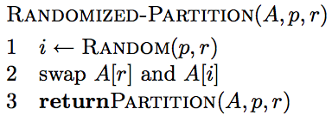
Another way to avoid the worst case?
Inject randomness into the data

Slide 56
What is the running time of randomized Quicksort?
Worst case?
Still could get very unlucky and pick “bad” partitions at every step
O(n²)

Slide 57
Final comments
Quicksort is the fastest known sorting algorithm
It is NOT stable
For optimum efficiency, the pivot must be chosen carefully
“Median of three” is a good technique for choosing the pivot
However, no matter what you do, there will be some cases where Quicksort runs in O(n²) time

